Slide 1
Coding in Python
Gianluca Palermo – gianluca.palermo@polimi.it

Slide 2

Target
To Learn the basic concepts behind computer programming
using Python as programming language
To Learn how to solve simple problems using a computer
To develop a simple Videogame!

Slide 3

Coding, What’s this?
Problem
- Use of the computer to simplify some data manipulation tasks
Specification
- Solution of the problem in a way that has been adapted to an automatic solution
Algorithm
Program
- Description of the algorithm in a way that can be understood by the automatic executor (Computer)
Automatic
Executor

Slide 4
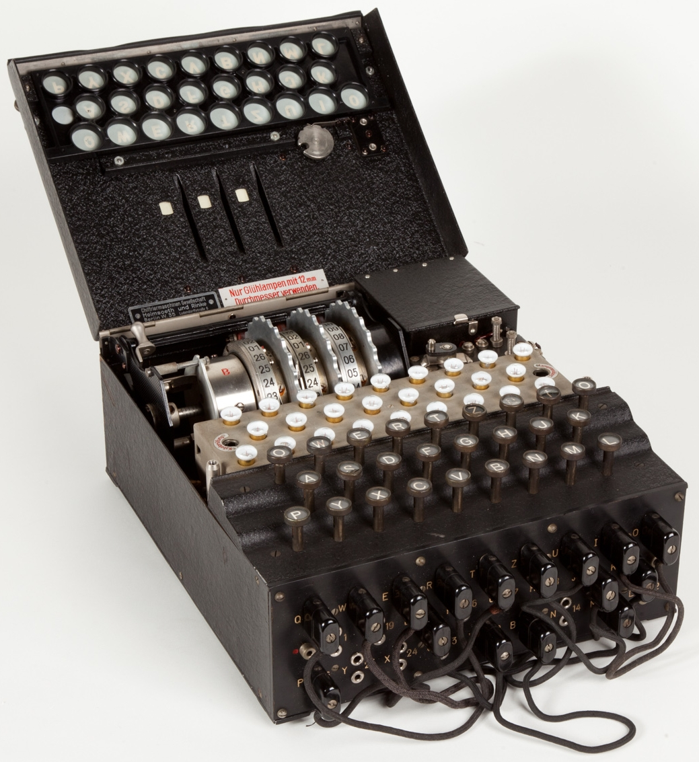
Computer History: From application specific machines… (one Task)
By Alessandro Nassiri - Museo della Scienza e della Tecnologia "Leonardo da Vinci", CC BY-SA 4.0, https://commons.wikimedia.org/w/index.php?curid=47910919
The Enigma machine is an encryption device developed and used in the early- to mid-20th century to protect commercial, diplomatic and military communication. It was employed extensively by Nazi Germany during World War II, in all branches of the German military.

Slide 5
…to programmable machines …

Slide 6
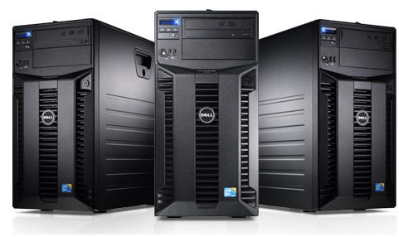
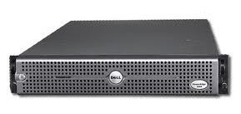
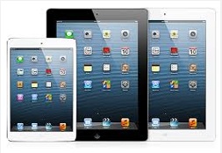

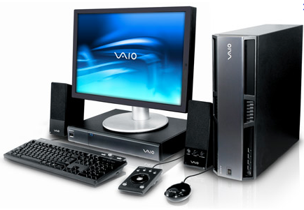

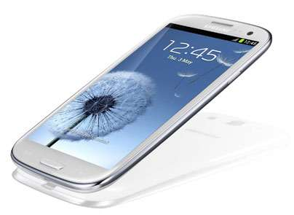
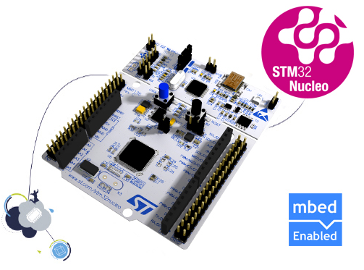
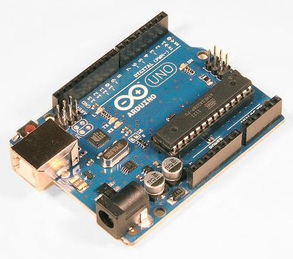
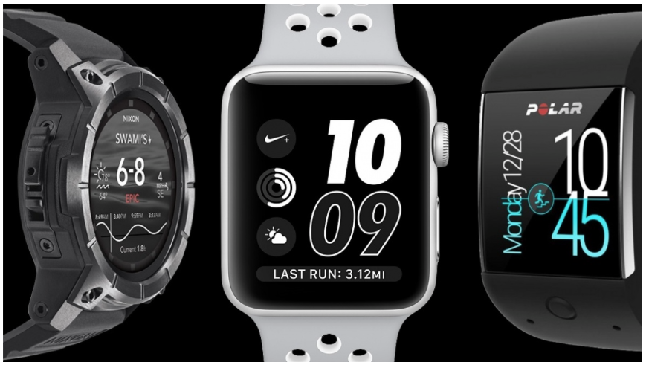
… easier to be managed …

Slide 7
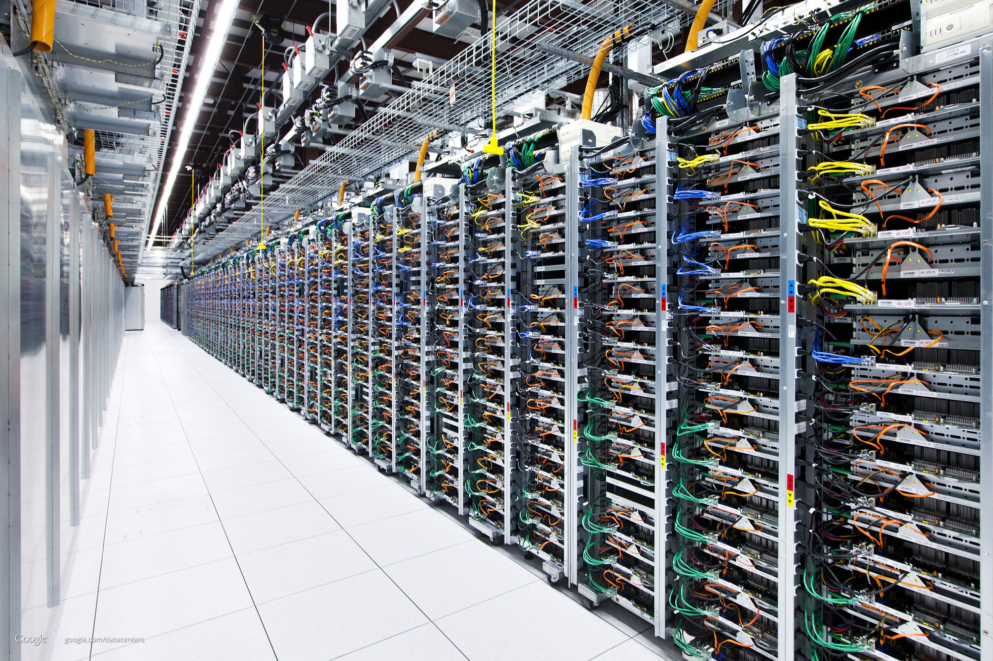
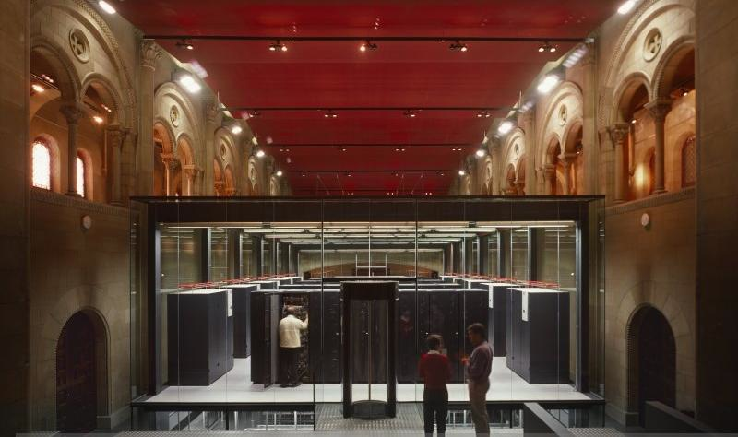
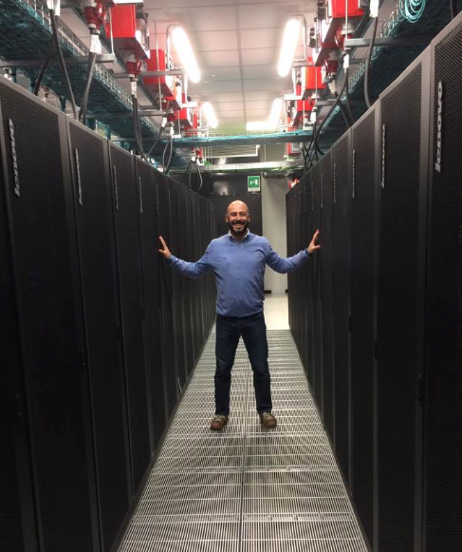
… or not ☺
https://www.youtube.com/watch?v=avP5d16wEp0

Slide 8
Connected and changing world…
We use every day “connected” computers.
However, The USER is not the PROGRAMMER

Slide 9
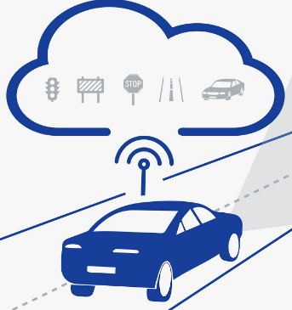
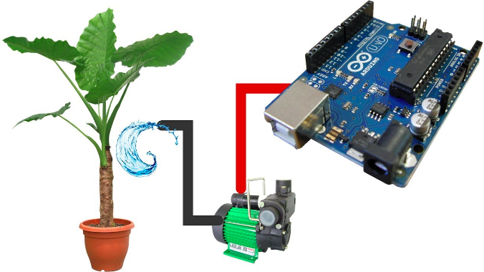
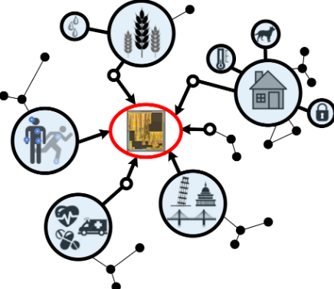

Why be a Programmer?
To get some task done automatically
Acting as user and programmer
E.g. Processing collected sensor data
To produce something for others to use
This is the task for a programmer as a job
Fix a performance problem in a videogame
Add a guestbook to a web site

Slide 10
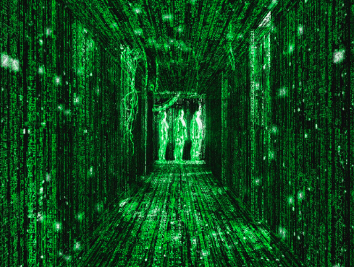
What is Code? Software? A Program?
A sequence of instructions
It is a little piece of our intelligence in the computer
We figure something out and then we encode it and then give it to someone else to save them the time and energy of figuring it out
A piece of creative art - particularly when we do a good job on user experience
Unfortunately the creativity of a programmer is not always exposed to the user. However, we know that it is there!

Slide 11
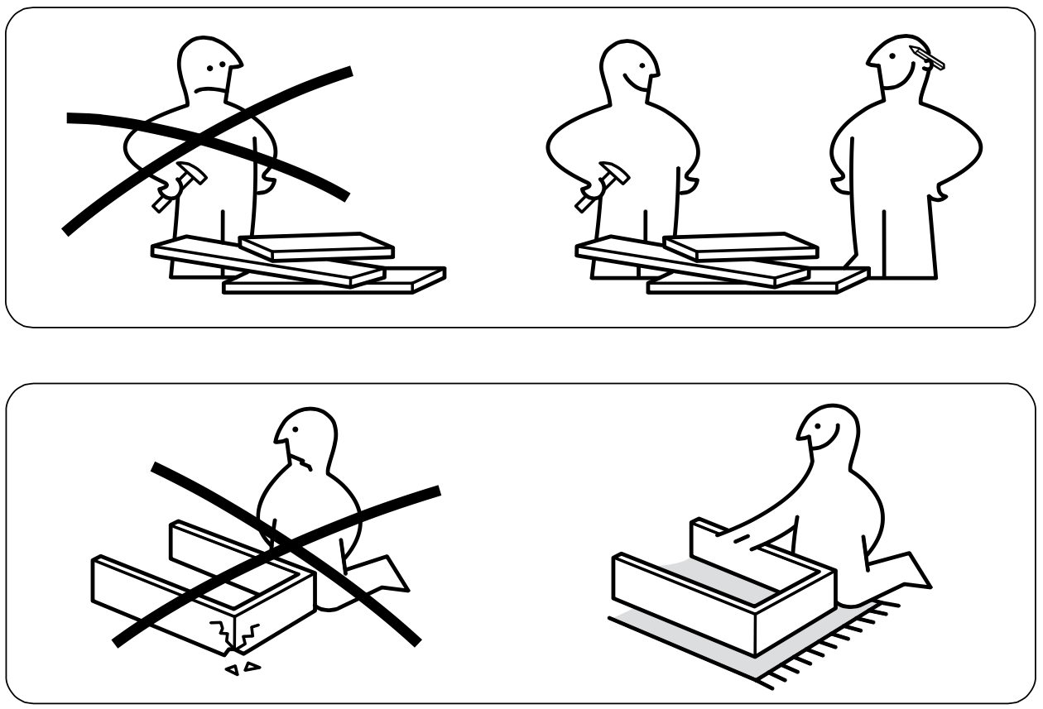
Programs for Humans

Slide 12
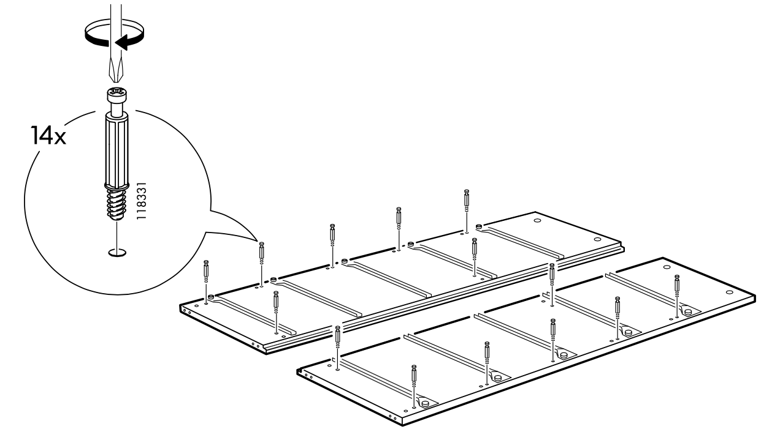
Programs for Humans

Slide 13
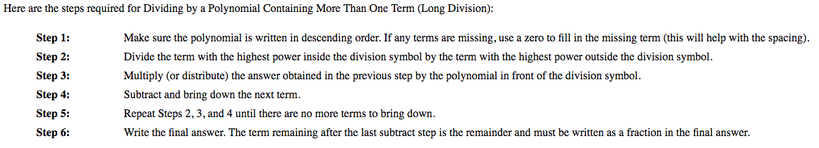
Programs for Humans
Multiplication by successive sums
ACC= M1*M2
Read M1 and M2
Initialize an accumulator to zero (ACC=0)
Repeat |M2| times
ACC=ACC+M1
If M2 is < 0
change the sign to ACC
Write ACC
Long Polynomial Division

Slide 14
Python programs … an example: “Is it a PANGRAM?”
text = input('Write a sentence: ')
Alphabet = ['a', 'b', 'c', 'd', 'e', 'f', 'g', 'h', 'i',
'j', 'k', 'l', 'm', 'n', 'o', 'p', 'q', 'r',
's', 't', 'u', 'v', 'w', 'x', 'y', 'z']
notAPangram = False
for letter in Alphabet:
if letter not in text:
notAPangram = True
if notAPangram:
print('the string is not a pangram')
else:
print('the string is a pangram')
A PANGRAM is a sentence including all the alphabet letters

Slide 15
Exercise
Let’s write a program/algorithm that using the following material puts together a sandwich

Slide 16
Algorithms, programs, executors and programming languages
An algorithm is a sequence of unambiguous instructions for solving a problem in a finite amount of time
A program is the encoding of the algorithm by using a programming language with the goal of being understood by the executor (the computer)
What is the language that can be understood by the computer?

Slide 17
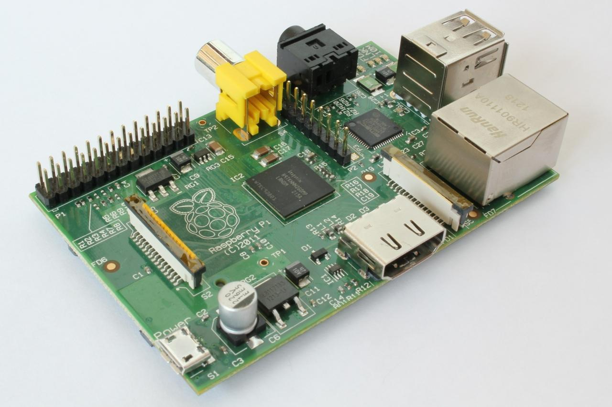
First of all, what do we mean as a computer?

Slide 18
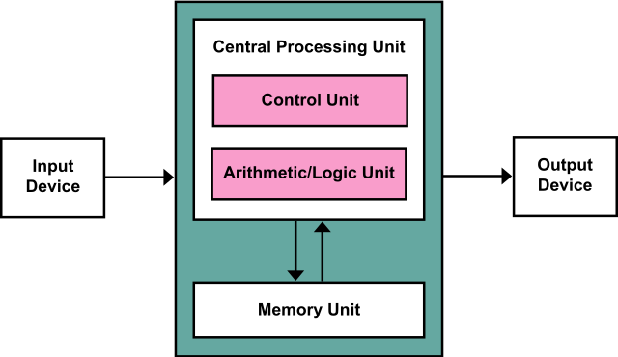
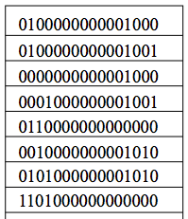
Von Neumann architecture
Including Data and Instructions

Slide 19
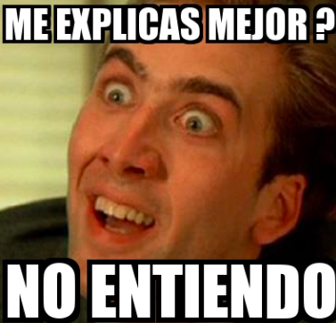
Compiling and interpreting
???
Program

Slide 20
Compiling and interpreting
Many languages (e.g. C/C++) require you to compile (translate) your program into a form that the machine understands.
Python is instead directly interpreted into machine instructions.
High-level
Language
Machine Language
Compiler
High-level
Language
Machine Language
Intepreter

Slide 21
Programming environments
An integrated development environment (IDE) is a software application that provides comprehensive facilities to computer programmers for software development
An IDE normally consists of:
A source code editor to easily write code
A compiler or interpreter, depending on the target language
A syntax checker (including syntax highlighting)
A debugger to control the correctness of the program execution

Slide 22
Python as Programming Language

Slide 23
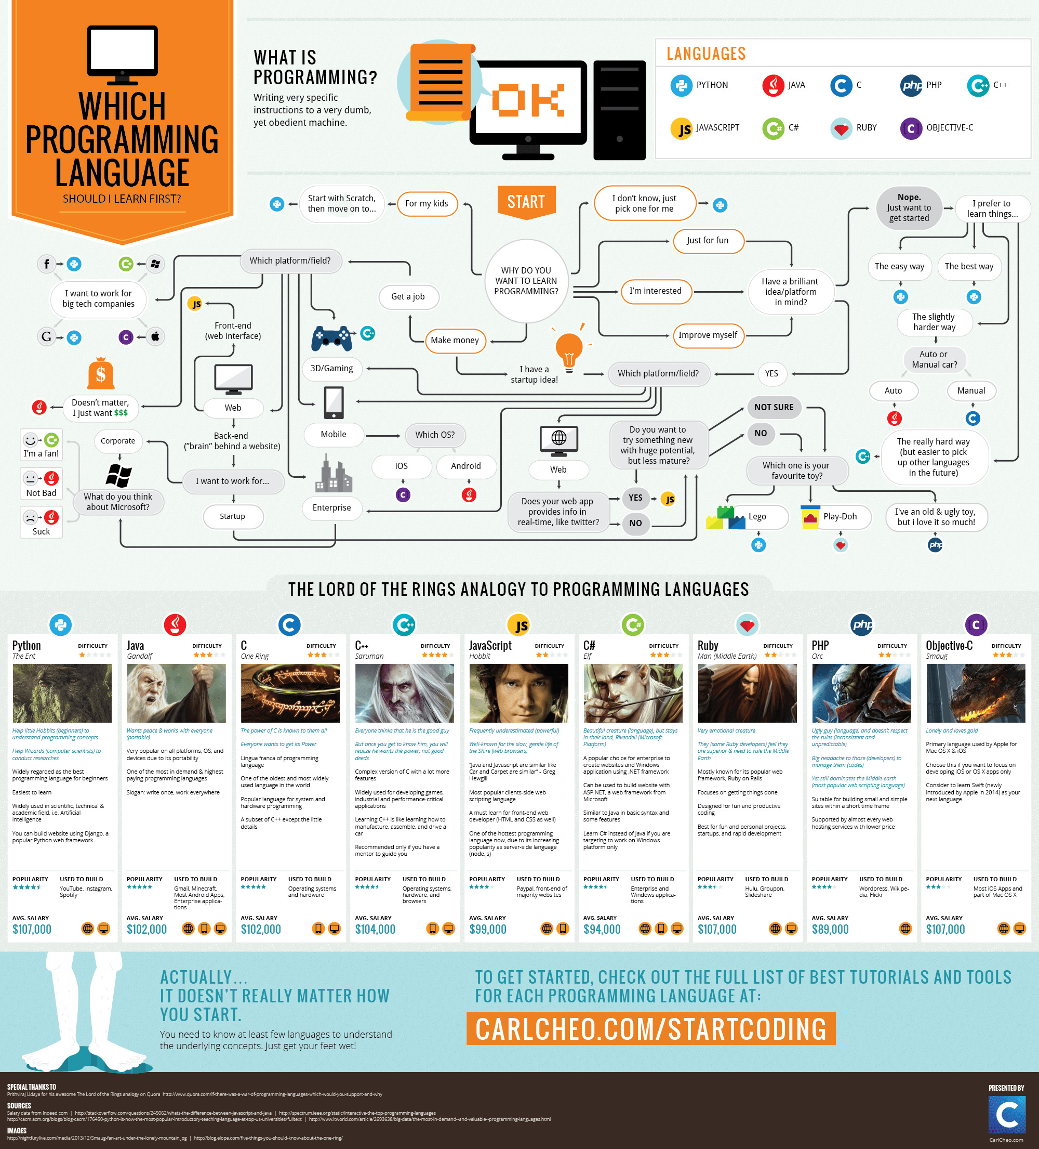
Languages

Slide 24
Languages

Slide 25
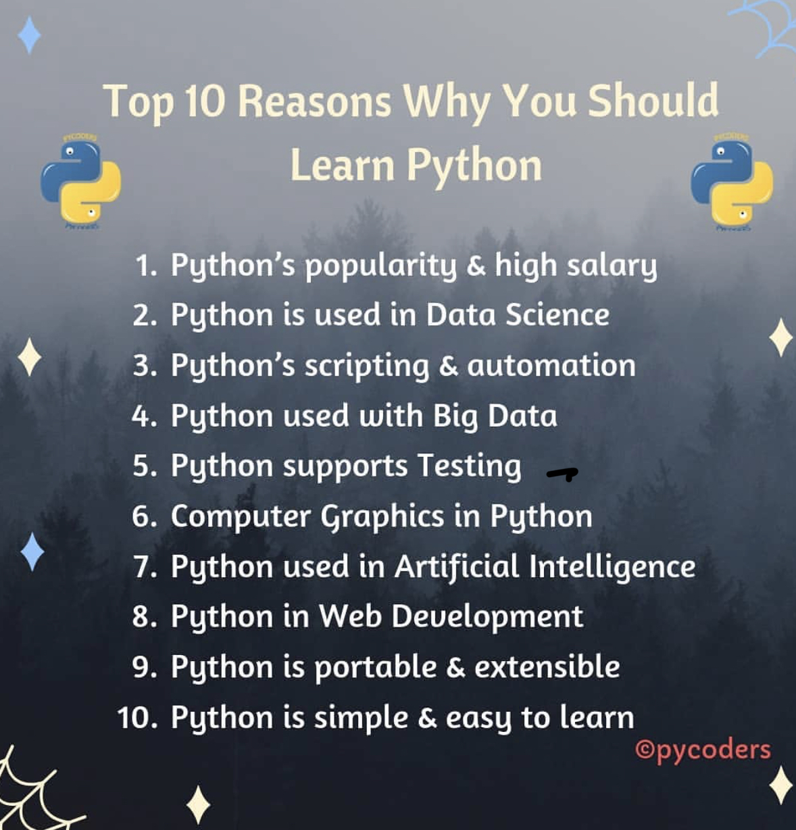
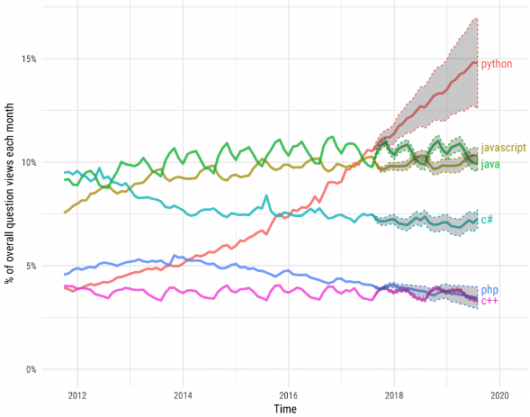
Why Python…
Python is an easy-to-learn programming language that has some really useful features for a beginning programmer
The code is quite easy to read and more natural to write when compared to other programming languages
Python has some characteristics that make the learning process easier, giving the possibility to develop an animation or a simple videogame in less than a week!
Python is the fastest-growing programming language

Slide 26
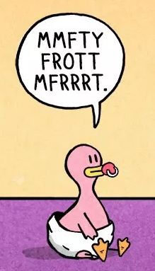

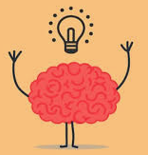
Early Learner: Advises
We need to learn the Python language, thus
We will “speak” gibberish like small children
We will make lots of mistakes
When you make a mistake
The computer says “syntax error”
It seems like Python is cruel and unfeeling
You must remember
You are intelligent and can learn
The computer is simple and very fast, but “cannot learn”
at least for the moment ;-)
It is easier for you to learn Python than for the computer to learn English...

Slide 27
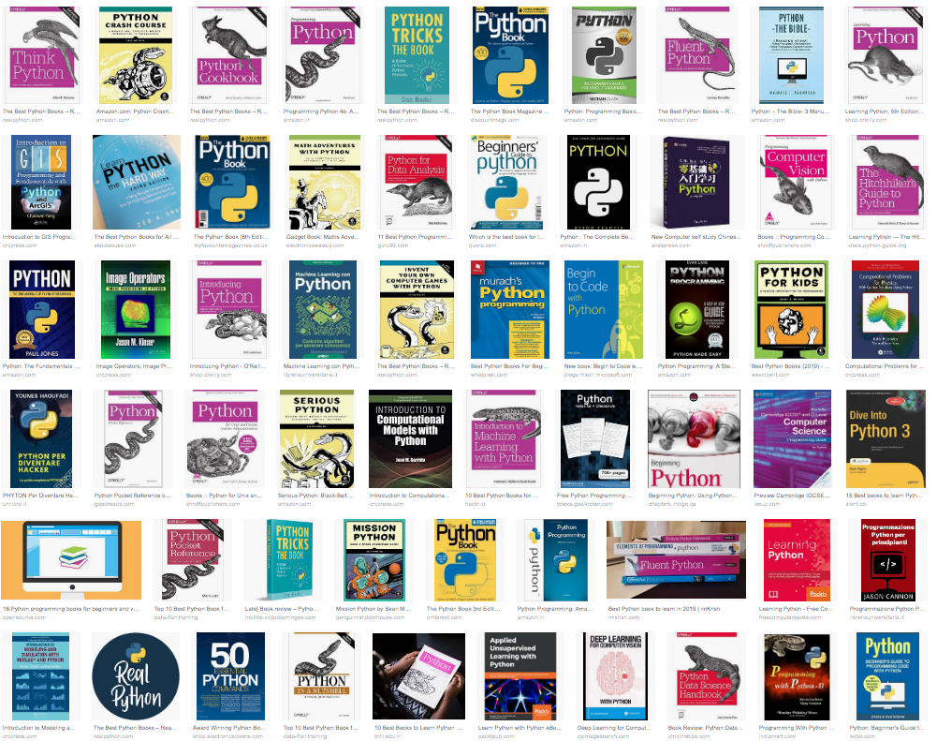
Elements of Python
Vocabulary / Words
Variables
Reserved words
Sentence structure
Valid syntax patterns
Story structure structure
constructing a program for a purpose

Slide 28

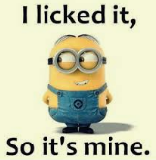
Vocabulary: Reserved Words
Reserved words are words with a specific mean in Python
False class return is finally
None if for lambda continue
True def from while nonlocal
and del global not with
as elif try or yield
assert else import pass
break except in raise

Slide 29
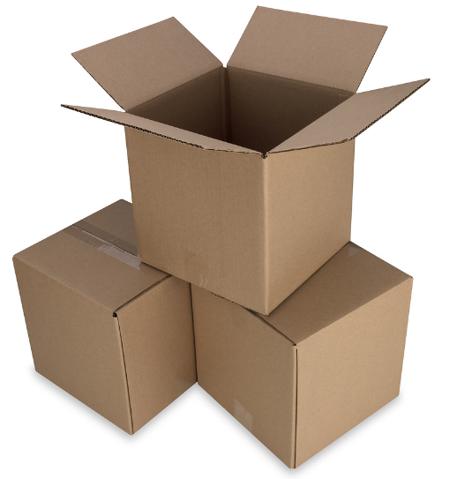
Vocabulary: Variables
A variable is a named place in the memory where a programmer can store data and later retrieve the data using the variable “name”
Programmers get to choose the names of the variables
You can change the contents of a variable in a later statement
x
12.2
x = 12.2
y = 14
y
14

Slide 30
Vocabulary: Variables
A variable is a named place in the memory where a programmer can store data and later retrieve the data using the variable “name”
Programmers get to choose the names of the variables
You can change the contents of a variable in a later statement
12.2
x
100
x = 12.2
y = 14
x = 100
y
14

Slide 31
Sentences: Instructions
x = 2
x = x + 2
print(x)
Assignment statement
Assignment with expression
Print statement
Variable
Operator
Constant
Function

Slide 32
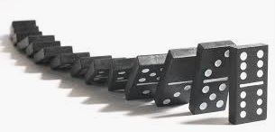

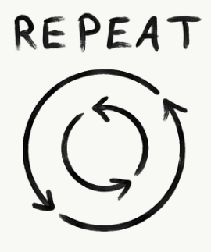
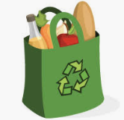
Program Steps or Program Flow
Like a recipe or installation instructions, a program is a sequence of steps to be done in order.
Some steps are conditional - they may be skipped.
Sometimes a step or group of steps is to be repeated.
Sometimes we store a set of steps to be used over and over as needed several places throughout the program (these are functions).

Slide 33
Sequential Steps
x = 2
Program:
x = 2
print(x)
x = x + 2
print(x)
Output:
2
4
print(x)
x = x + 2
print(x)
When a program is running, it flows from one step to the next. As programmers, we set up “paths” for the program to follow.

Slide 34
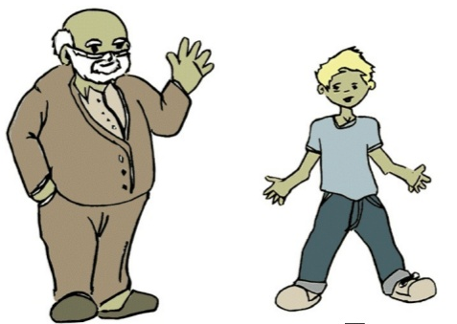
Conditional Steps
x = 5
x < 15 ?
Yes
Program:
x = 5
if x < 10:
print(’Young')
if x > 20:
print(’Old')
print(’End')
print(’Young')
Output:
Young
End
No
x > 30 ?
Yes
No
print(’Old')
print(’End')

Slide 35
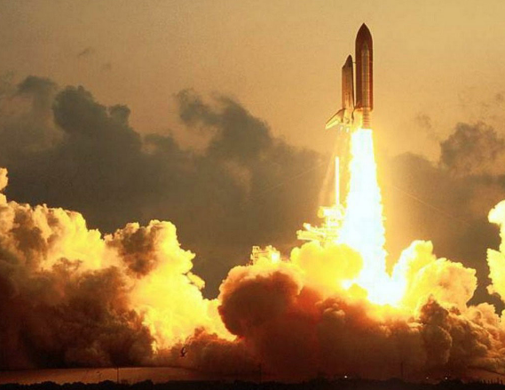
Repeated Steps
n = 5
No
n > 0 ?
Yes
Program:
n = 5
while n > 0 :
print(n)
n = n – 1
print('Blastoff!')
Output:
5
4
3
2
1
Blastoff!
print(n)
n = n -1
print('Blastoff')
Loops (repeated steps) have iteration variables that change each time through a loop.

Slide 36
Classifying the instructions of our first example…
text = input('Write a sentence: ')
Alphabet = ['a', 'b', 'c', 'd', 'e', 'f', 'g', 'h', 'i',
'j', 'k', 'l', 'm', 'n', 'o', 'p', 'q', 'r',
's', 't', 'u', 'v', 'w', 'x', 'y', 'z']
notAPangram = False
for letter in Alphabet:
if letter not in text:
notAPangram = True
if notAPangram:
print('the string is not a pangram')
else:
print('the string is a pangram')
Sequential
Repeated
Conditional

Slide 37
Words, sentences and paragraphs
A short Python “Story” about how identifying pangrams
A word used to read data from a user
A sentence about considering all alphabet letters
A paragraph about informing the usage of the program outcome
text = input('Write a sentence: ')
Alphabet = ['a', 'b', 'c', 'd', 'e', 'f', 'g', 'h', 'i',
'j', 'k', 'l', 'm', 'n', 'o', 'p', 'q', 'r',
's', 't', 'u', 'v', 'w', 'x', 'y', 'z']
notAPangram = False
for letter in Alphabet:
if letter not in text:
notAPangram = True
if notAPangram:
print('the string is not a pangram')
else:
print('the string is a pangram')

Slide 38
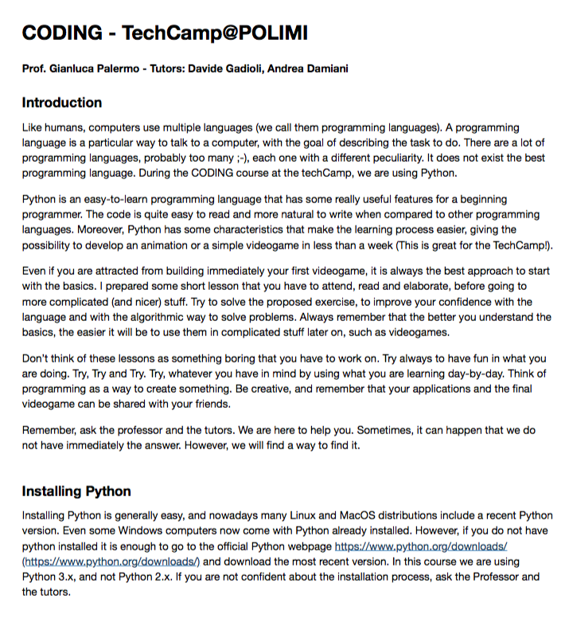
… We have almost done!!!

Slide 39
Input and Output in Python

Slide 40
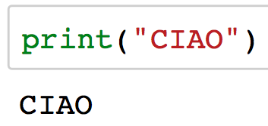
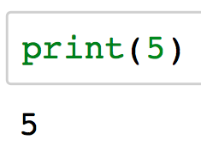
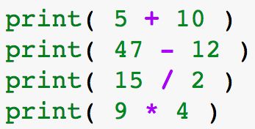
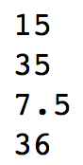
print( SOMETHING ) … SOMETHING

Slide 41
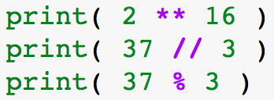
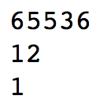
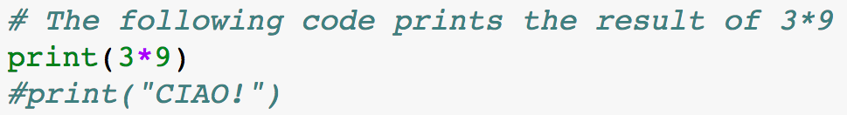
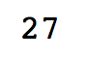
print( SOMETHING ) … SOMETHING (2)
This is a comment

Slide 42

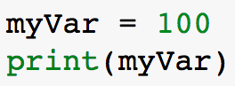
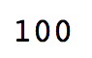
Variables
Variable
name
Assignment
operator
Constant
value
myVar

Slide 43
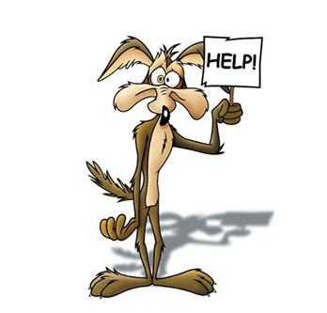
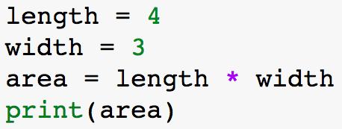
Area of a rectangle! Area = Length * Width
How can I solve the problem by using what I just learnt in Python?
3
4

Slide 44

Area of a rectangle! Area = Length * Width (2)
How can I solve the problem by using what I just learnt in Python?
3
4
How can I get those data as input?

Slide 45
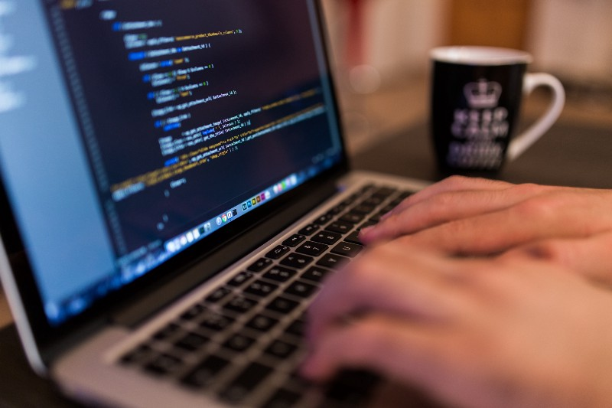


Obviously… with input( )!!!
The program works with data unknown to the programmer
Input( )
The problem to solve is the same but with different data!
text
print( )

Slide 46
Input( SOMETHING )
This text will be shown while “asking” for the input data
“+” when used with STRINGS of characters means concatenation

Slide 47


Sum A+B
A
?
+
Input( )
S
print( )
B

Slide 48
Sum A+B
5
A
9
?
+
Input( )
S
print( )
4
B

Slide 49

Sum A+B
What?!
5
A
9
54
+
input( )
S
print( )
4
B

Slide 50

Input( ) reads STRINGS of characters!
“5”
A
“54”
54
+
input( )
S
print( )
“4”
B
Try using s = a*b

Slide 51


Data conversion functions: cast operations
int( … )
str( … )
“5”
5
5
“5”

Slide 52
Area of a rectangle! Area = Length * Width (3)
How can I solve the problem by using what I just learnt in Python?
3
4
How can I get those data as input?

Slide 53

Area of a rectangle! Area = Length * Width (Final)
How can I solve the problem by using what I just learnt in Python?
width
length

Slide 54
Floating Point Numbers and Modules

Slide 55



Variable types
Distance in meter
Can’t be simply an integer number
distance

Slide 56



Real numbers – float( )
Python can also manipulate real numbers.
Examples: 6.022 -15.9997 42.0 2.143e17
Decimal Separator
“54.36”
54.36
54.36
input( )
float( )
X
“54.36”
str( )

Slide 57
Some useful built-in functions
int( … )
float( … )
5.3
5
5
5.0
int( … )
5.6
5
In addition to conversion and I/O functions there are other useful built-in functions in Python
min( … )
abs( … )
round( … )
3, 7
3
-5
5
5.3
5
max( … )
abs( … )
round( … )
3, 7
7
5
5
5.8
6

Slide 58




Python Modules
Not all the functions are built-in…
import module_name
module_name.function_name( )

Slide 59





Useful Math functions
Command name | Description
ceil(value) | rounds up
floor(value) | rounds down
log(value) | logarithm, base e
log10(value) | logarithm, base 10
sin(value) | sine, in radians
cos(value) | cosine, in radians
sqrt(value) | square root
[…]
Constant | Description
e | 2.7182818...
pi | 3.1415926...

Slide 60





Useful “Random” functions

Slide 61
Conditional Statements

Slide 62


Conditions
walk()
person = meet_someone()
say(“Hello!”)
walk()
walk()
person = meet_someone()
if person is nice:
say(“Hello!”)
walk()
Do you really want to say “hello” to everyone?

Slide 63






if(-elif)-else
4 spaces or 1Tab

Slide 64
Conditions
Many logical expressions use relational operators:
Logical expressions can be combined with logical operators:
Operator | Meaning | Example | Result
== | equals | 1 + 1 == 2 | True
!= | does not equal | 3.2 != 2.5 | True
< | less than | 10 < 5 | False
> | greater than | 10 > 5 | True
<= | less than or equal to | 126 <= 100 | False
>= | greater than or equal to | 5.0 >= 5.0 | True
Operator | Meaning | Example | Result
and | True if both True, False otherwise | 9 != 6 and 2 < 3 | True
or | True if at least one True, False otherwise | 2 == 3 or -1 < 5 | True
not | True if False, False otherwise | not 7 > 0 | False

Slide 65
Loops

Slide 66
Need of iterative constructs
How many persons or for how much time?
[…]
walk()
person = meet_someone()
say(“Hello!”)
walk()
person = meet_someone()
say(“Hello!”)
walk()
person = meet_someone()
say(“Hello!”)
walk()
[…]
while not arrived:
walk()
person = meet_someone()
say(“Hello!”)
for persons on the way:
walk()
person = meet_someone()
say(“Hello!”)

Slide 67

For loop
Repeats a set of statements over a group of values
4 spaces or 1Tab
variableName = A
statements
variableName = B
statements
variableName = C
statements
B
A
C
groupOfValues

Slide 68




Range( )

Slide 69
Exercise:
Write a program that computes the factorial (n!) of an integer

Slide 70


While loop
Executes a group of statements as long as a condition is True.
good for indefinite loops (repeat for an unknown number of times)
Same as for IF
If condition == True:
Loop-Body
If condition == True:
Loop-Body
If condition == True:
Loop-Body
[…]
4 spaces or 1Tab

Slide 71

Example and Exercise:
Exercise: Write a program that reads numbers from the input until the input is an even number.

Slide 72
Lists & Maps

Slide 73

Lists
Useful to store multiple data (typically of the same type).
Months
Print all the months
month1= “January”
month2 = “February”
month3 = “March”
[…]
print(month1)
print(month2)
print(month3)
[…]
months= [“January”, “February” , “March”, …]
print(months)
or
for x in months:
print(x)

Slide 74





Lists manipulation
myList
CAT
Pos: 0 1 2
“FROG” | “CAT” | “SPIDER”
“FROG” | “DOG” | “SPIDER”
“FROG” | “MOUSE” | “CAT” | “DOG”
“FROG” | “CAT” | “SPIDER” | “DOG”
“FROG” | “CAT” | “DOG”

Slide 75





Other useful stuff on lists
in and not in operators
Others…
len(myList) returns the number
of elements of the list

Slide 76




Something “more” on Strings
Strings can be seen as a sequence of characters
Characters in a string are numbered as in lists
To access an individual character of a string:
variableName [ index ]
index | 0 | 1 | 2 | 3 | 4 | 5 | 6 | 7
character | G | I | A | N | L | U | C | A
name

Slide 77
Modularity

Slide 78


Functions
Functions help breaking our program into smaller and modular chunks
more organized and manageable
Functions avoid repetition and makes code reusable
Input
Compute
Output

Slide 79


Functions
Let’s suppose that I would like to say “hello” to every person I meet in my school…

Slide 80
PyGame!!!

Slide 81


The graphic window
The basic step for a videogame is to create its graphic window
Module inclusion and initialization
Display settings declaration and customization
Closure of the graphic module at the very end of the program

Slide 82


Main game loop
Fill the background of the screen
Quit
Detect the event that are happening during the “game” life
Update the screen with the new graphic elements (if any) ☺

Slide 83

Graphical elements
Command | Description
pygame.draw.line(surface,color,(x1,y1),(x2,y2),thickness) | Draws a line between (x1, y1) and (x2, y2) with a certain thickness
pygame.draw.circle(surface,color,(x,y),radius,thickness) | Draws an circle centered in (x,y), with a certain radius and thickness. If thickness is missing, the circle will be filled.
pygame.draw.rect(surface,color,[x,y,width,height],thickness) | Draws a rectangle with a top-left corner at (x,y), and a certain width, height and thickness. If thickness is missing, the rectangle will be filled.
[…] more at https://www.pygame.org/docs/ref/draw.html

Slide 84


Animation:
It is enough to draw the same item at different x/y positions within the game loop
I removed the “cleaning” of the screen
We can use a variable and update its value
It is used to limit the speed of the animation (FrameRate)

Slide 85


More on animations:
You can easily make the circle bouncing from left to right, or in any direction
Or you can make disappearing the rectangle when hit by the ball

Slide 86



Text and Images

Slide 87

Other possible interactions
Mouse Pressed
Detects the position of the cursor in the game window. It can be used also outside the event detection loop
Detects when a button of the keyboard has been pushed and which one
More event.key can be found at
https://www.pygame.org/docs/ref/key.html

Slide 88













Its your turn!!!
Snake
Arkanoid/Pong
Flappy Bird
Shot the balloon
Space Invaders
Asteroids
TicTacToe
Cannon Ball
Scissor-Paper-Rock
Hangman
Cross Road
Car Race
Other possibilities: 4in a Row, simplified version of Candy Crush, temple run …

